Slide 1
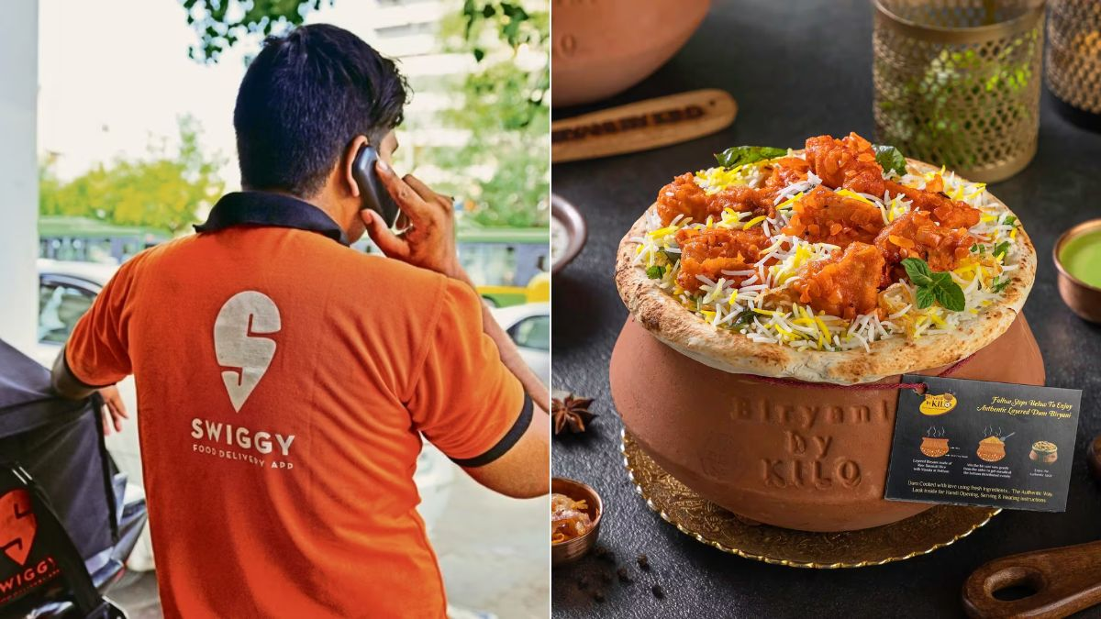

Title:- Swiggy Database Analysis Subtitle: Insights and Queries
BY :-
FAIZAN SAIFI
DATA ANALYST

Slide 2
Swiggy :- Case Study
BY :-
FAIZAN SAIFI
DATA ANALYST
Swiggy is an Indian online food delivery and restaurant aggregator platform headquartered in Bangalore, India. Launched in August 2014, Swiggy has become one of the leading food delivery services in India. The platform connects users with local restaurants, allowing them to order food online and have it delivered to their doorstep.

Slide 3
Key features and aspects of Swiggy include:
BY :-
FAIZAN SAIFI
DATA ANALYST
Wide Range of Restaurants: Swiggy collaborates with a diverse range of restaurants, offering users an extensive choice of cuisines and dishes.
User-Friendly App and Website: Swiggy provides a user-friendly mobile app and website that allows customers to browse menus, place orders, and track deliveries with ease.
Quick and Reliable Delivery: Swiggy focuses on providing quick and reliable food delivery services. The platform uses a network of delivery partners to ensure timely deliveries.
Live Order Tracking: Users can track the status of their orders in real-time through the app, providing transparency and convenience.
Offers and Discounts: Swiggy frequently offers discounts, promotions, and cashback options, making it an attractive choice for cost-conscious consumers.

Slide 4
Key features and aspects of Swiggy include:
BY :-
FAIZAN SAIFI
DATA ANALYST
Swiggy Super: Swiggy Super is a subscription-based loyalty program that offers benefits such as free delivery, no surge fees during peak hours, and exclusive member-only deals.
Payment Options: Swiggy supports various payment options, including online payment through credit/debit cards, digital wallets, and cash on delivery.
Restaurant Ratings and Reviews: Users can read and leave reviews for restaurants, helping others make informed decisions about where to order.
Expansion: Swiggy has expanded its services to numerous cities across India and has ventured into various food-related initiatives, such as cloud kitchens and grocery delivery.

Slide 5
Agenda:-
BY :-
FAIZAN SAIFI
DATA ANALYST
Certainly! Here is the list of the 10 queries that will be covered in the presentation:
Find customers who have never ordered.
Average price per dish.
Find the top restaurant in terms of the number of orders for a given month (May, June, and July).
Restaurants with monthly sales greater than a specified amount (e.g., 500) for May.
Show all orders with order details for a particular customer in a specific date range (e.g., Ankit's orders between June 15 and July 31, 2022).
Find restaurants with the maximum number of repeated customers.
Month-over-month revenue growth of Swiggy.
Month-over-month revenue growth of a specific restaurant.
Customer's favorite food.
Most paired food items.

Slide 6
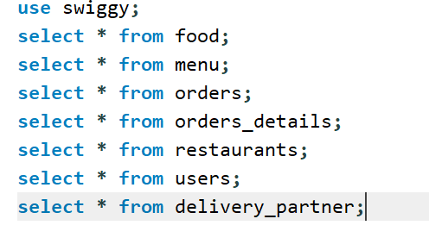
About Data:-
BY :-
FAIZAN SAIFI
DATA ANALYST

Slide 7
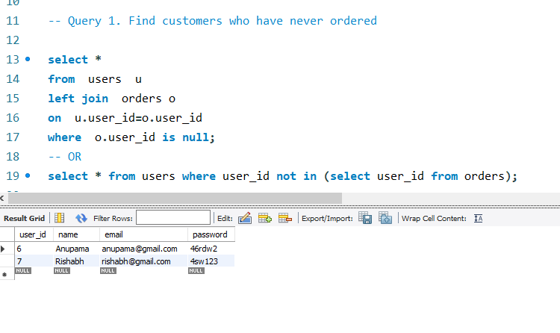
Query 1. Find customers who have never ordered
BY :-
FAIZAN SAIFI
DATA ANALYST

Slide 8
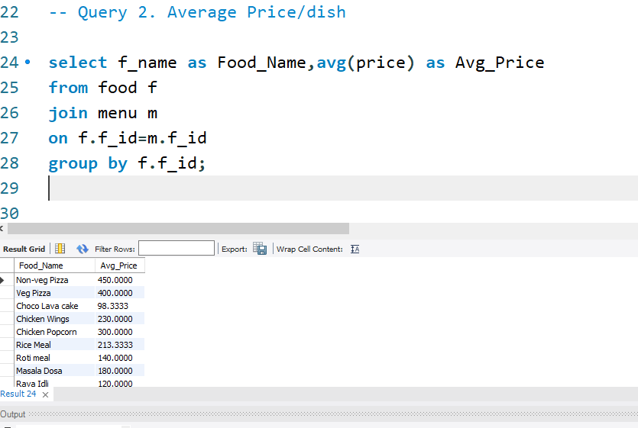
Query 2. Average Price/dish
BY :-
FAIZAN SAIFI
DATA ANALYST

Slide 9
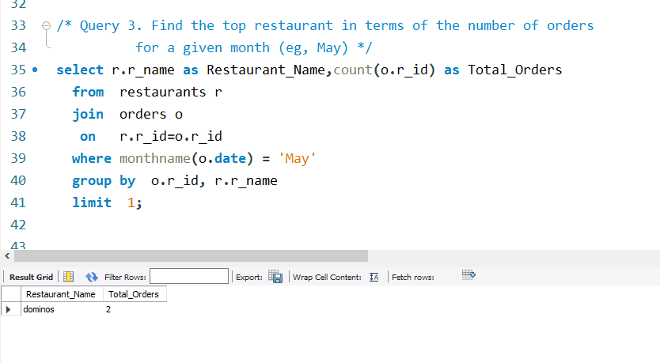
Query 3. Find the top restaurant in terms of the number of orders for a given month
BY :-
FAIZAN SAIFI
DATA ANALYST

Slide 10
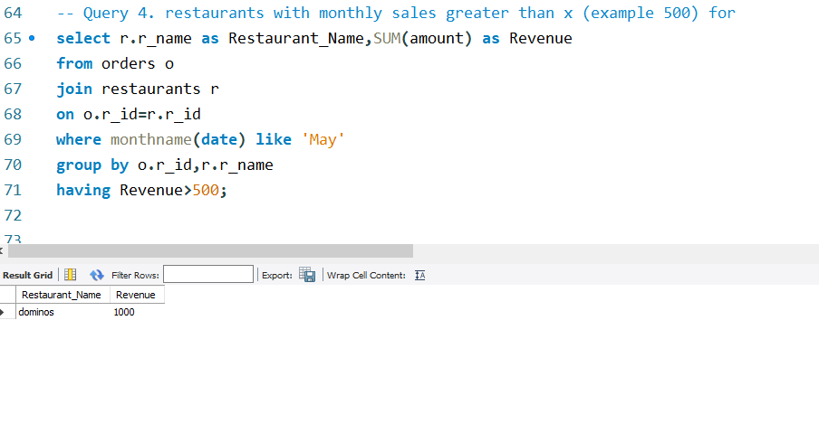
Query 4. restaurants with monthly sales greater than x (example 500) for
BY :-
FAIZAN SAIFI
DATA ANALYST

Slide 11
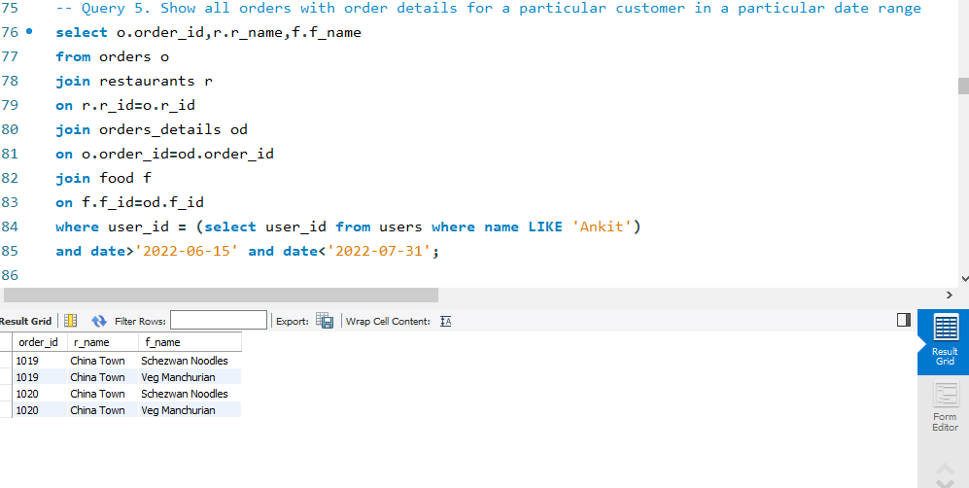
Query 5. Show all orders with order details for a particular customer in a particular date range
BY :-
FAIZAN SAIFI
DATA ANALYST

Slide 12
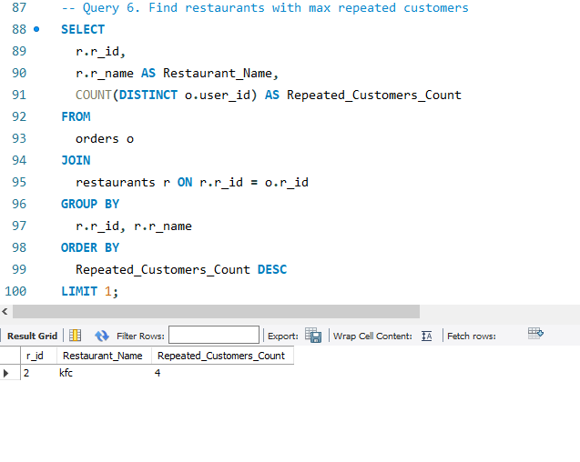
Query 6. Find restaurants with max repeated customers
BY :-
FAIZAN SAIFI
DATA ANALYST

Slide 13
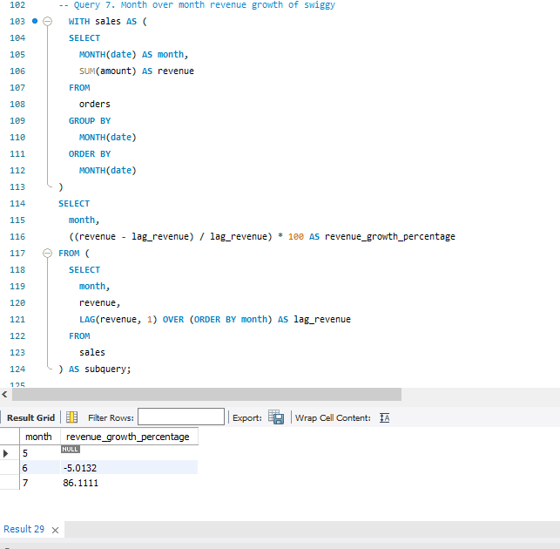
Query 7. Month over month revenue growth of swiggy
BY :-
FAIZAN SAIFI
DATA ANALYST

Slide 14
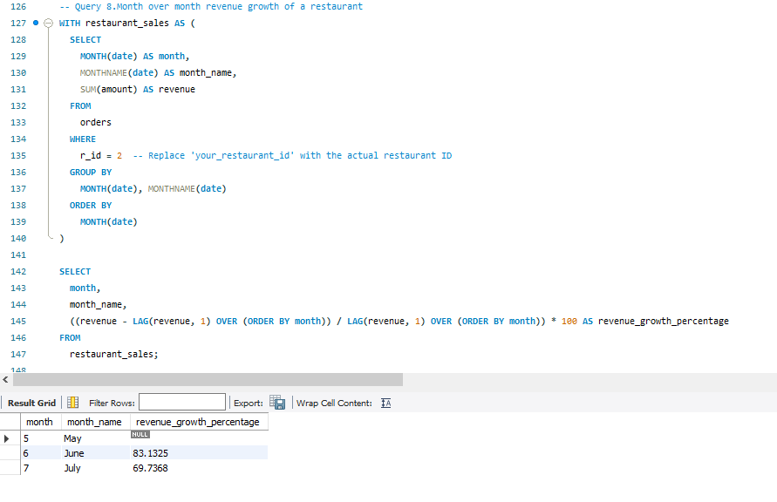
Query 8.Month over month revenue growth of a restaurant
BY :-
FAIZAN SAIFI
DATA ANALYST

Slide 15
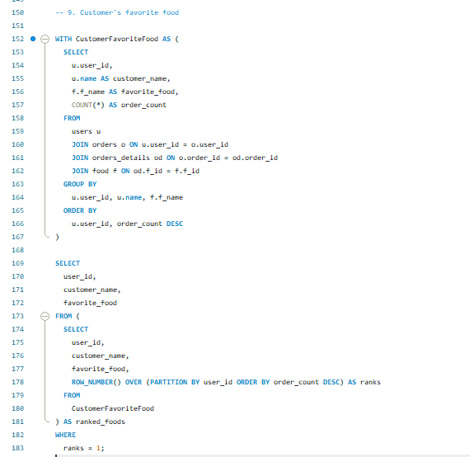
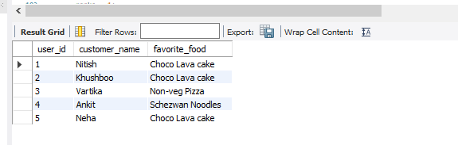
Query 9. Customer's favorite food
BY :-
FAIZAN SAIFI
DATA ANALYST

Slide 16
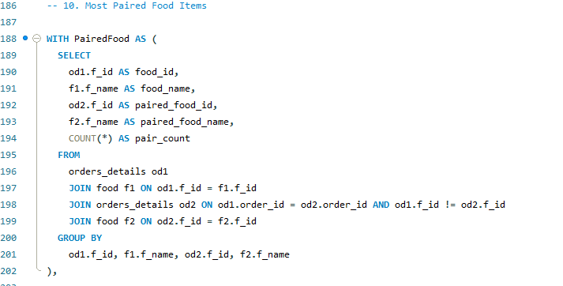
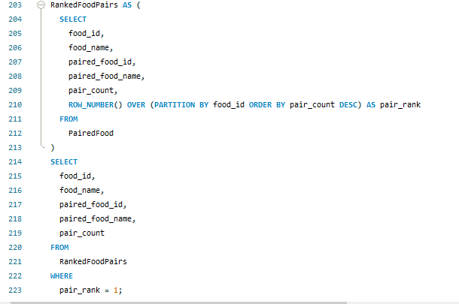
10. Most Paired Food Items
BY :-
FAIZAN SAIFI
DATA ANALYST

Slide 17
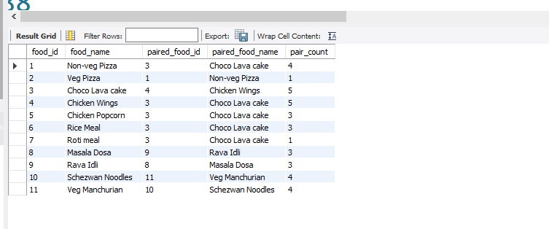
Most Paired Food Items Results
BY :-
FAIZAN SAIFI
DATA ANALYST

Slide 18
Data Insights from Swiggy Case Study:-
BY :-
FAIZAN SAIFI
DATA ANALYST
Customers Who Have Never Ordered:
Identify potential customer outreach opportunities for promotions or engagement campaigns.
Understand the percentage of inactive users in the platform.
Average Price per Dish:
Determine the average cost of dishes to set competitive pricing strategies.
Identify high or low-priced dishes for menu optimization.
Top Restaurant by Monthly Orders:
Recognize popular restaurants to strengthen partnerships or marketing efforts.
Understand customer preferences and trending restaurants.
Restaurants with Monthly Sales > X:
Identify high-performing restaurants for potential collaborations.
Monitor and reward successful restaurants to maintain a healthy partnership.
Customer's Orders in a Date Range:
Analyze a specific customer's ordering behavior over time.
Understand peak ordering periods for targeted marketing.

Slide 19
Data Insights from Swiggy Case Study:-
BY :-
FAIZAN SAIFI
DATA ANALYST
Restaurants with Max Repeated Customers:
Recognize and reward restaurants with a strong customer retention rate.
Identify strategies for retaining and attracting more customers.
Month-over-Month Revenue Growth of Swiggy:
Assess overall platform performance and growth trends.
Identify peak months and potential seasonality.
Month-over-Month Revenue Growth of a Restaurant:
Evaluate a specific restaurant's growth trends.
Identify periods of increased or decreased revenue.
Customer's Favorite Food:
Understand popular menu items among specific customers.
Use insights for targeted marketing or personalized promotions.
Most Paired Food Items:
Identify frequently paired dishes for menu bundling or promotions.
Optimize menu suggestions for customers.

Slide 20

End of Slides
BY :-
FAIZAN SAIFI
DATA ANALYST

